Slide 1

Portfolio Executive Committee (PEC) Review Meeting
TA MHEH
To insert a wordmark:
Add (e.g. via drag and drop) your wordmark file (in RGB) to this slide (in alignment with our brand governance and architecture guidelines)
Change the size of the wordmark according to the height reference (magenta placeholder)
Select the “guides” in the navigation bar and move the wordmark to the right and top line (orange)
  Meiruo Liu, Freya Zhu, Jingbo Xiao | 15 December 2025 | 10 min

Slide 2
Part I:
Follow-up Actions from the Previous PEC
PEC action log

Slide 3
Part II: Discussion/Endorsement

Slide 4
Part III: Update

Slide 5
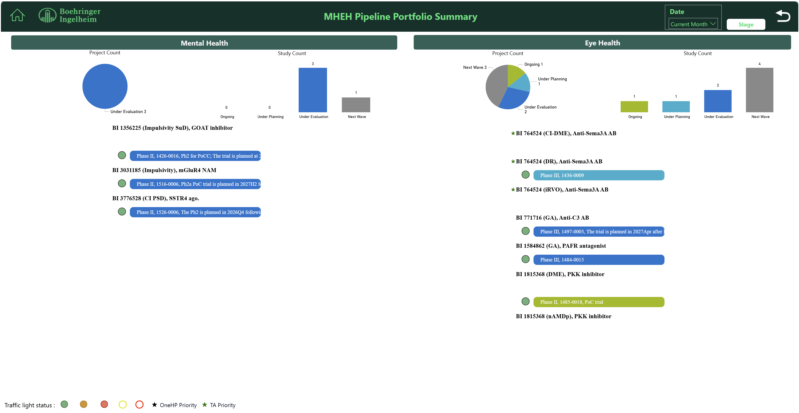
TA MHEH Portfolio Summary - Pipeline Projects
Status change:
New SoDs in Eye Health:
  BI 3817491 anti‑VEGF/TNFα in nAMD: SoD in Nov
  BI 3986283 BCL-xL inhibitor in DR: SoD in Nov
  STING inh. IVT XT in DR/DME: SoD in Dec
Completion/Termination:
  BI 3797479 COMTi in CIAS: the frontrunner asset was terminated in Nov 2025, and a backup asset will be evaluated.

Slide 6
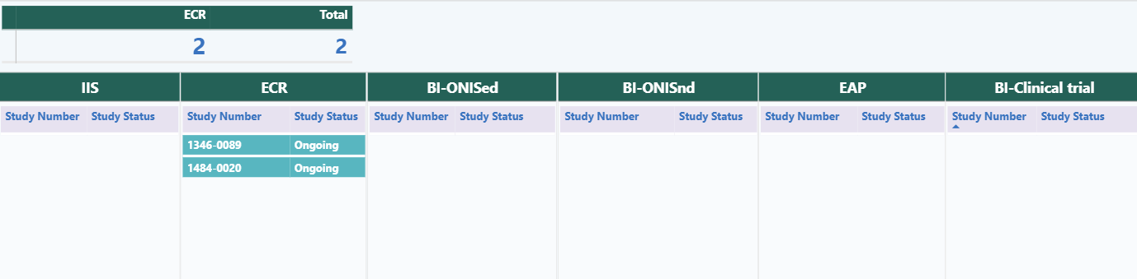
TA MHEH Portfolio Summary - PMS Studies
BJ-PERFECT (VR)
COMPASS

Slide 7
Eye Health Assets

Slide 8


BI 764524 / Anti-Sema3A, Diabetic Retinopathy (DR), Development Plan
2025 |  |  |  | 2026 |  |  |  | 2027 |  |  |  | 2028 |  |  |  | 2029 |  | 2030
Q1 | Q2 | Q3 | Q4 | Q1 | Q2 | Q3 | Q4 | Q1 | Q2 | Q3 | Q4 | Q1 | Q2 | Q3 | Q4 | H1 | H2 | H1 | H2
Today
Ph2b -
1436-0007
CRIMSON
May 2024
Apr 2026
May 2027
Oct 2027
Ph2b in NPDR without CI-DME, CRIMSON, N=178
FPI
LPI
52-wk key results
Final results
Cumulative 8m Postponed
May 2028
May 2029
May 2030
Sep 2030
PoC
2 x Ph3 in NPDR wo CI-DME
1 x Ph3 in PDR
Ph3 -
1436-0009/
1436-0010/
1436-0012
FPI
LPI
52-wk
primary results
NDA sub.
Ph3 -
1436-0009/
1436-0010/
1436-0012
May 2029
Oct 2030
China Update:
  DR/DME based on Beijing Healthcare Insurance Study was discussed with global brand teams of Anti-Sema3A and PKKi on 24 Nov 2025. Proposal will be updated for further review.
  A brief proposal on sponsoring Prof Jie LI’s China RWS of natural course progression of DR and RNP will be prepared for global team’s review.
CTA Review + EC + HGRAC + 1st SIV
Ph3 in NPDR without CI-DME
Ph3 in PDR
CTA Sub
1st SIV
LPI
CN NDA sub.
8
DR: Diabetic Retinopathy; CI-DME: Center-Involved Diabetic Macular Edema; RNP: Retinol Non-Perfusion; PRP: Panretinal Photocoagulation

Slide 9
BI 771716 / Anti-C3 AB, Geographic Atrophy (GA), Development Plan
2025 |  |  |  | 2026 |  |  |  | 2027 |  |  |  | 2028 |  |  |  | 2029 |  | 2030
Q1 | Q2 | Q3 | Q4 | Q1 | Q2 | Q3 | Q4 | Q1 | Q2 | Q3 | Q4 | Q1 | Q2 | Q3 | Q4 | H1 | H2 | H1 | H2
Today
Jan 2025
Sep 2025
May 2026
Jan 2027
Global Update:
aC3 situational analysis is ongoing to prepare for GBP workshop in Feb 2026.
Updated development plan and timeline needs to be endorsed in IUEC Jan 2026.
Ph2 -
1497-0002
VERDANT
VERDANT Ph2b in GA, N=180 (US)
FPI
LPI
IA
Key results
LPI achieved 4m ahead of plan!
Oct 2029
Apr 2030
Dec 2030
PoC/RoFD
Oct 2027
Oct 2028
Ph3 -
1497-0003/
1497-0004
2 x Ph3 in GA
FPI
LPI
Primary results
NDA sub.
Key results
Ph3 -
1497-0003/
1497-0004
May 2030
CTA Review + EC + HGRAC + 1st SIV
Ph3 in GA
CTA Sub
1st SIV
LPI
NDA sub.
China Update:
After initial discussion with Anti-C3 CDL and GRA in Nov, GA pipeline consultation of Anti-C3 and PAFR was preferred and need to be further aligned with global TA level.
The GA scientific exchange meeting with Prof. Xiaodong Sun’s team is rescheduled to Dec 2026 due to time feasibility (TBD).
9
Notes:
Izervay, the C5 inhibitor from Astellas, with registrational trials (GATHER1 & GATHER2 in US/EU) demonstrating positive results in reduction in GA lesion growth but no significant effect in visual function, was approved by FDA (2023), rejected by EMA, and now conditionally approved by PMDA in Sep 2025 waiving clinical data in Japanese patients. External information shows that an experts consultation panel was organized by CDE recently to evaluate Izervay approval in China waiving clinical data in Chinese patients. Local team is closely monitoring on the status.

Slide 10
BI 1584862/ PAFR Antagonist, Geographic Atrophy (GA), Development Plan
2025 |  |  |  | 2026 |  |  |  | 2027 |  |  |  | 2028 |  |  |  | 2029 |  | 2030
Q1 | Q2 | Q3 | Q4 | Q1 | Q2 | Q3 | Q4 | Q1 | Q2 | Q3 | Q4 | Q1 | Q2 | Q3 | Q4 | H1 | H2 | H1 | H2
Today
Global Update:
PMDA was consulted in Nov 2025, based on Japanese Phase 1 data to waive Japan dose finding before ph3. Global team will define concrete activities in 2026 for Asian (China/Japan) integration.
Ph2 -
1484-0005
JADE
Jan 2025
Aug 2026
May 2027
JADE Ph2 in GA, N=138 (US)
FPI
IA
Key results
Ph3 -
1484-0015
Feb 2028
PoC
Ph3 in GA
FPI
Oct 2024
Jun 2025
Mar 2026
Jul 2026
Dec 2027
Dec 2028
RWE -
1484-0020
Proposal + Contract + 1st SIV
COMPASS ECR in GA
CTA Sub
FPI
1st IA
LPI/
2nd IA
3rd IA
Final Report
Ph3 -
1484-0015
China Update:
After initial discussion with Anti-C3 CDL and GRA in Nov, GA pipeline consultation of Anti-C3 and PAFR was preferred and need to be further aligned with global TA level.
CTA Review + EC + HGRAC + 1st SIV
Ph3 in GA
CTA Sub
1st SIV
10

Slide 11
BI 1815368 / PKKi, Diabetic Macular Edema (DME), Development Plan
2025 |  |  |  | 2026 |  |  |  | 2027 |  |  |  | 2028 |  |  |  | 2029 |  | 2030
Q1 | Q2 | Q3 | Q4 | Q1 | Q2 | Q3 | Q4 | Q1 | Q2 | Q3 | Q4 | Q1 | Q2 | Q3 | Q4 | H1 | H2 | H1 | H2
Today
Global Update:
DME Ph2:
  Trial status: IA/PoC delay due to recruitment challenge will be confirmed in Jan 2026.
nAMD Ph2:
  2nd indication (nAMD) ph2 to be accelerated
  Asian Adboard on development strategy scheduled in Jan 2026 in Shanghai.
Jun 2026
Sep 2026
Nov 2027
Ph2 -
1485-0018
THULITE
May 2025
THULITE Ph2, N=300
FPI
IA
LPI
Key results
Ph3 -
1485-0019/
1485-0020
PoC
2 x Ph3
FPI
Aug 2028
Mar 2025
Jan2026
Feb2026
Sep 2026
Nov 2027
Ph2 -
1485-0018
THULITE
CTA Review + EC + HGRAC + Contract
Ph2, N=8
Key results
CTA Sub
CoA
1st SIV
LPI
THULITE China Preparation:
CTP amendment: global amendment (IN/EX, rescue, etc) and local amendment (CIQ) ongoing
Study Status:
  IMP delayed risk mitigated by local IMP coordination with global, 2-3 weeks due to CoA with FPI potentially delayed from end of Feb to mid Mar
  Dry SIV planed end of Jan 2026. China Investigator Meeting preparation on track (2026-01-10)
  Site engagement plan: co-SIVs planned; Ad hoc site visits based on situation need.
  Global activities in Shanghai: leading site visit and internal workshop
IMP relabel + shipment
11
China CIQ: China Entry-Exit Inspection and Quarantine; nAMD: neovascular age-related macular degeneration

Slide 12
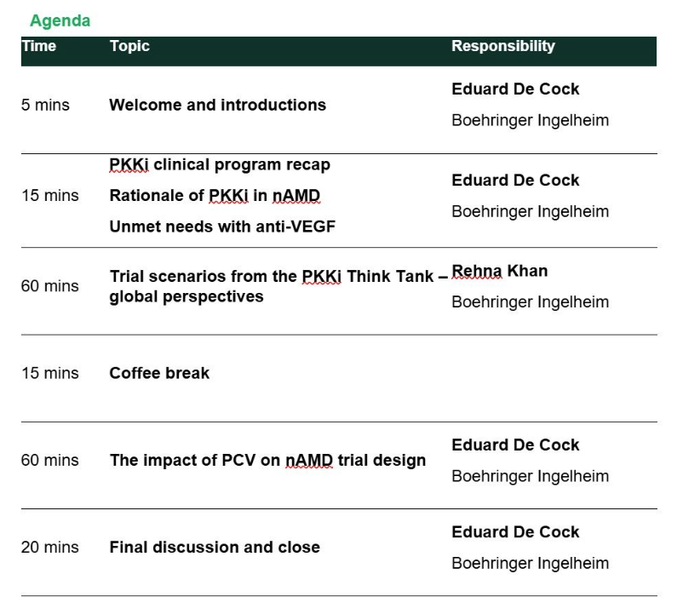

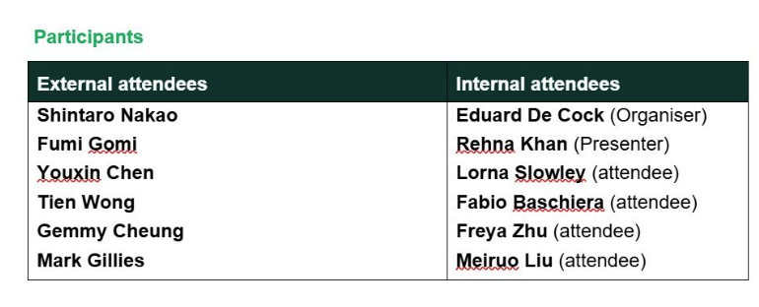
PKKi Asia Advisory Board Meeting in Shanghai on Jan 9th
KEEs from China, Japan and Singapore were invited. Two Chinese KEEs, Prof. Youxin Chen has accepted the invitation. Prof. Xiaodong Sun TBD.

Slide 13
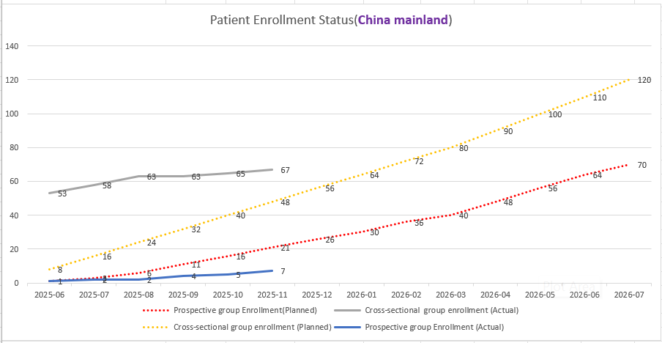
1484-0020 COMPASS BI 771716 / Anti-C3 AB, GA, China Recruitment
Cut-off date: 2025.11.30
Total Enrollment:
Prospective group: 7/70
Cross-sectional group: 67/120
Site initiation: 7/16
Recruitment Curve
Follow up actions update after visiting PI to discuss study progress (10 Nov 2025) :
  Sponsor –PI and his team will re-evaluate recruitment timeline by the end of Dec 2025.
  For study imaging cases discussion meeting, Sub-I will contact BI when they determined the meeting date
  We will continue to follow up with PI on interim data analysis (based on current collected data) and result publication plan.

Slide 14
SCOMPASS (1484-0020) GA Study Progress Overview
Substance/ MOA/ Formulation | Indication | Study type (Study no.: FPI-LPO, CTR) | China Dev. Strat. | Current status | Next Milestone | Key Updates
PAFR and anti-C3 | GA | ECR 1484-0020 (Jun2025-Jul-2028, Dec 2028) | China alone | FPI （Jun 2025） | 1st interim analysis （Mar 2026） | Proposal was released on 24 Sep 2024 Protocol was approved on 28 Nov 2024 Contract was signed on 12 May 2025. Study recruitment progress: Retrospective part: 120/65(+2 than last month); Prospective part: 70/5(+1 than last month); Site initiation progress: 16/5(+0 than last month)
Monthly update
Study team have met with PI and his team on 10 Nov 2025, to discuss study progress (includes sub-sites initiation and subjects screening)

Slide 15
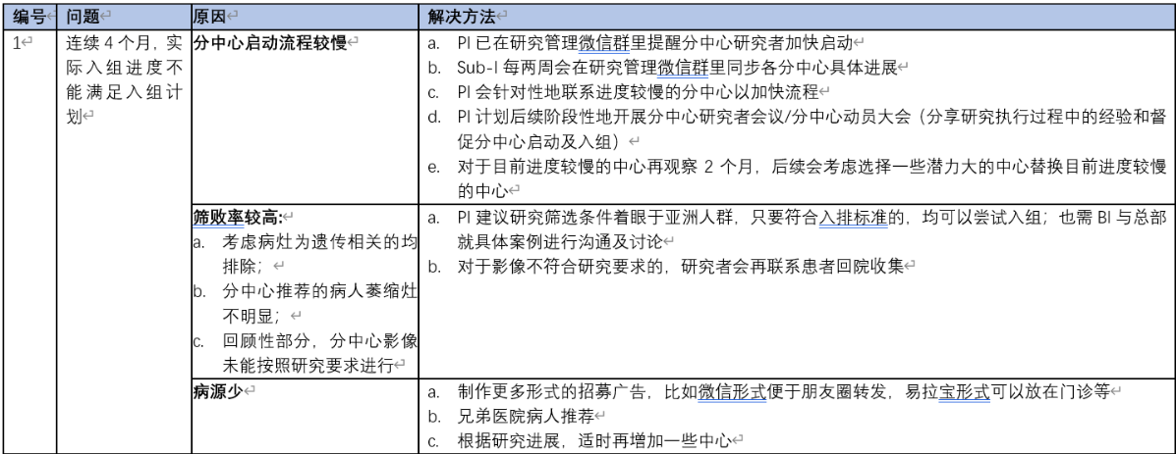
Visit PI on 10 Nov 2025
Investigator shared Sub-sites progress
Discussion on recruitment issue:
Follow-up actions

Slide 16
Mental Health Assets

Slide 17
BI 3031185 / mGluR4 NAM, Impulsivity, Development Plan
2025 |  |  |  | 2026 |  |  |  | 2027 |  |  |  | 2028 |  |  |  | 2029 |  | 2030
Q1 | Q2 | Q3 | Q4 | Q1 | Q2 | Q3 | Q4 | Q1 | Q2 | Q3 | Q4 | Q1 | Q2 | Q3 | Q4 | H1 | H2 | H1 | H2
Today
Ph1b -1516-0003
Jan 2025
Aug 2026
Ph1b PoM in ADHD & BPD, N=80 (GR)
Global Update:
Impurity found during MRD may delay timeline. Further test is ongoing.
Path to PoC strategy (incl. PoC design) will be endorsed in IUEC Q1 2026.
FPI
Key results
Observational study -
1516-0030
Observational COA
Ph2 -
1516-0006
Ph2a PoC in BPD
H2 2029
BTD sub.
Ph2 -
1516-0006
CTA Review + EC + HGRAC + 1st SIV
Ph2a PoC in BPD
H2 2029
BTD sub.
CTA Sub
1st SIV
China Update: 1:1 consultations to understand BPD and impulsivity in BPD in China
Prof. Jun Tong (童俊) from Wuhan Mental Health Center:
  ~20/month BPD patients in outpatient clinic.
  Most BPD patients present due to impulsivity symptoms.
  A database for BPD (~ 270 cases) with impulsivity assessment results (＞80 cases) has been identified.
Consultation with Prof. Zhen Wang (王振) from Shanghai Mental Health Center is planned on Thursday (19th Dec).
Key insights will report back to global in Jan/Feb 2026 after all consultations are completed.
17
ADHD: Attention-Deficit/Hyperactivity Disorder; BPD: Borderline Personality Disorder; COA: Clinical Outcome Assessment
Notes:
Observational study预计在美国做。现在COA在开发中，会在Observational study中使用
PoC还在计划中，明年初会更加清楚。
中国 integration plan等PoC更加清楚后继续讨论。目前需要做的：了解BPD以及impulsivity in BPD在国内的情况，潜在site和PI

Slide 18
BI 1356225 / GOATi, Impulsivity SUD, Development Plan
2025 |  |  |  | 2026 |  |  |  | 2027 |  |  |  | 2028 |  |  |  | 2029 |  | 2030
Q1 | Q2 | Q3 | Q4 | Q1 | Q2 | Q3 | Q4 | Q1 | Q2 | Q3 | Q4 | Q1 | Q2 | Q3 | Q4 | H1 | H2 | H1 | H2
Today
Ph1b -
1427-0015
Jan 2025
Aug 2026
Ph1b PoM, N=60 (US)
Cocaine DDI
FPI
Key results
Ph2 -
1427-0016/
1427-0017
Jan 2028
Jan 2030
Ph2 PoC in Opioid Use Disorder (OUD)
Ph2 PoC in Cocaine Use Disorder (CUD)
FPI
Key results
Global Update:
11 Dec IUPC endorsed to continue PoM study. The key results will be delayed to Apr 2027, and cocaine DDI-study will be postponed from Aug 2026 to May 2027.
China Update:
China team will catch up with the Innovation team by mid Jan 2026 to revisit China integration into PoC in OUD.
PoC/RoFD
Ph2 -
1427-0016/
1427-0017
CTA Review + EC + HGRAC + 1st SIV
Ph2 PoC in Opioid Use Disorder (OUD)
Ph2 PoC in Cocaine Use Disorder (CUD)
CTA Sub
1st SIV
Key results
18
Impulsivity SuD: Impulsivity Substance Use Disorders; OUD: Opioid Use Disorder; CUD: Cocaine Use Disorder; CSP: Chinese Society of Psychiatry
Notes:
PoM for OUD（Ph1b）进行中，入组缓慢。主要原因是4-CSRTT筛查冲动失败率高。已经在9月修改了protocol。本来预计26年8月完成研究，但很可能完不成。会看看改了protocol之后入组会不会加快，年底再过IUPC
中国 integration等总部ph1b年底的IUPC再进一步沟通

Slide 19
BI 3776528 / SSTR4 Agonist, CI PSD, Development Plan
2025 |  |  |  | 2026 |  |  |  | 2027 |  |  |  | 2028 |  |  |  | 2029 |  | 2030
Q1 | Q2 | Q3 | Q4 | Q1 | Q2 | Q3 | Q4 | Q1 | Q2 | Q3 | Q4 | Q1 | Q2 | Q3 | Q4 | H1 | H2 | H1 | H2
Today
Aug 2026 (4m delayed)
Ph1 –
1526-0001
Jan 2025
Ph1 SRD & MRD, N=118
FPI
Key results
Ph1b -
1526-0006
Oct 2026
Feb 2028
Ph2 PoM (US only)
Pan-Asian Ph1/DDI
FPI
Key results
Ph2 -
1526-0014
Aug 2029
Global Update:
The 1526‑0006 trial is currently being revised as a PoM study with 3 arms x 25 patients, which is planned in US only considering fMRI vendor feasibility and less variability.
Path to PoC will be discussed in IUPC in Feb 2026.
Ph2 PoC
FPI
Ph2 -
1526-0014
CTA Review + EC + HGRAC + 1st SIV
Ph2 PoC
CTA Sub
1st SIV
CI PSD: Cognitive Impairment in Psychosis Spectrum Disorders;
19
Notes:
SRD和MRD预计延迟4个月，26年8月完成
PoCP（PoM）不变，目前计划只在US做
2期研究的plan（path to PoC）会在今年底上IUPC
中国integration plan，年底后与global catch up

Slide 20
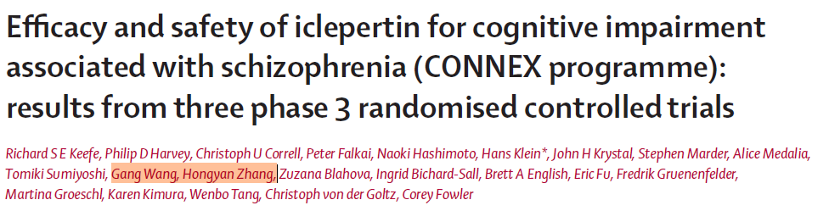
Mental Health Ongoing Projects
Project | Description | Leading KEE | Key Update | Next Step
BJ-PERFECT study | ECR study Aim to validate the functional capacity evaluation tool (BJ-PERFECT VR) and explore CIAS link to function. Meanwhile collect disease and economic burden of CIAS | 石川 | Recruitment: Ongoing. 110 pts (150 planned) and 689 HCs (750 planned) have been enrolled By the end of Nov. (89%) | Enrollment completion is expected by the end of 2025.
Checklist Development | Develop a simplified checklist using Delphi methodology for quick screening/identification of CIAS | 石川 | The project is completed as planned | -
CIAS review | Comprehensive review of CIAS literature in China, including epidemiology, burden and impact, potential pathophysiological mechanisms, clinical assessment methods, and treatment updates. | 司天梅 蒲城城 | Manuscript is resubmitted to the Jornal 《中国心理卫生杂志》 on 10th Oct. | Waiting for 《中国心理卫生杂志》feedback
CONNEX Pooled publication ​ | Oral presentation at SIRS congress – Apr.1st ​ Manuscript: ​ Prof. Gang Wang and Prof. Zhang had reviewed and provided feedback​ Target journal: Lancet Psychiatry ​ 1st Submission date: June 12th, 2025​ 2nd Submission date: Aug.29th , 2025 (comments received on Aug.5th)​ Published by Lancet Psychiatry on 13th Nov.
Efficacy and safety of iclepertin for cognitive impairment associated with schizophrenia (CONNEX programme): results from three phase 3 randomised controlled trials - The Lancet Psychiatry

Slide 21
Thank You!

